Slide 1
Image Analysis Sem 1 AY 2024-2025

Slide 2
Overview of today’s lecture
Types of image transformations.
Point image processing.
Linear shift-invariant image filtering.
Convolution.
Image gradients.

Slide 3
Slide credits
Most of these slides were adapted directly from:
Kris Kitani (15-463, Fall 2016).
Inspiration and some examples also came from:
Fredo Durand (Digital and Computational Photography, MIT).
Kayvon Fatahalian (15-769, Fall 2016).

Slide 4
Types of image transformations

Slide 5
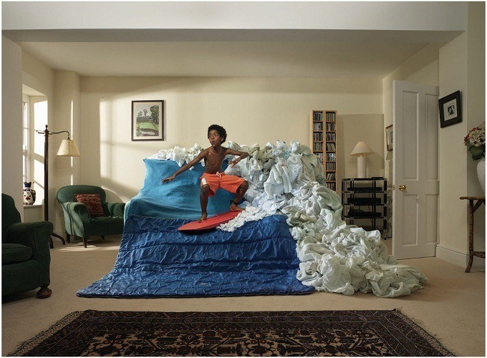
What is an image?

Slide 6
What is an image?
A (color) image is a 3D tensor of numbers.

Slide 7
What is an image?
red green
blue
colorized for visualization
Each channel is a 2D array of numbers.
color image patch
How many bits are the intensity values?
actual intensity values per channel

Slide 8
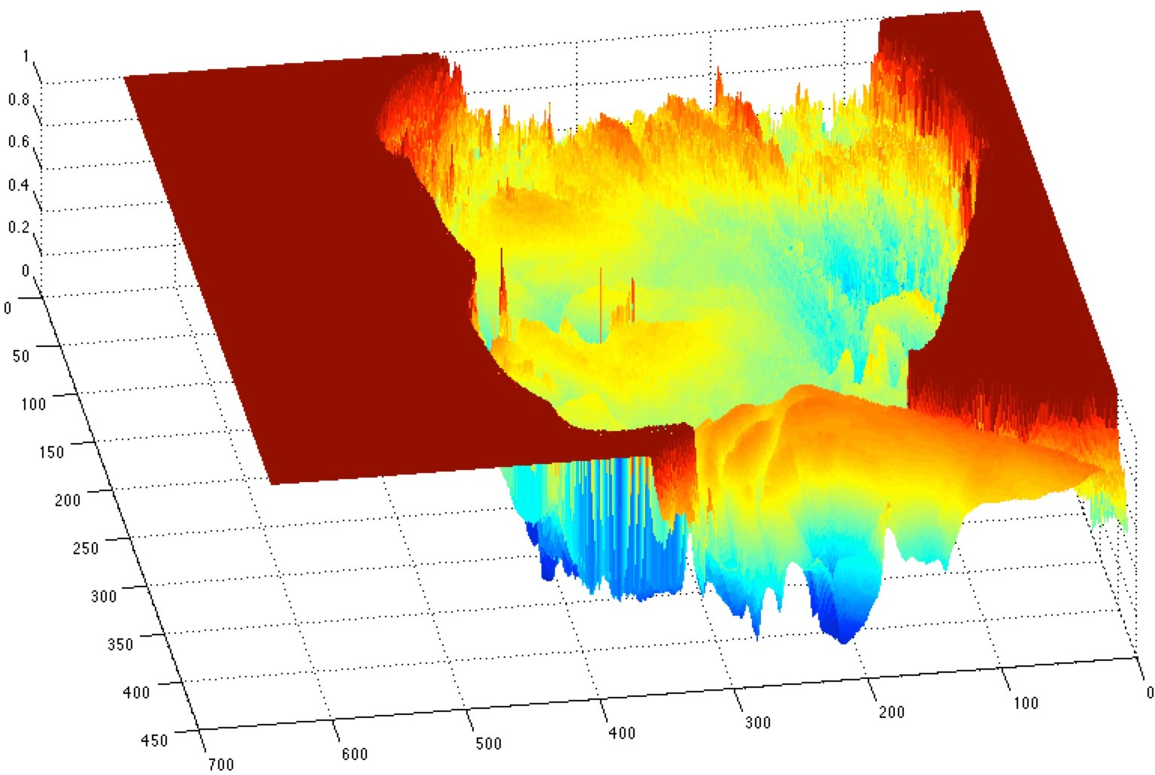
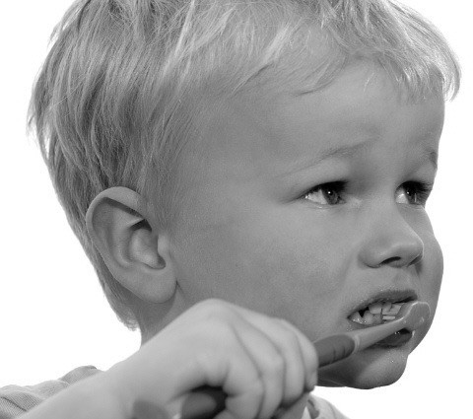
What is an image?
A (grayscale) image is a 2D function.
grayscale image
What is the range of the image function f (0-255)?
domain
Domain for the colored Image$x=[ x$
Y
Z]

Slide 9
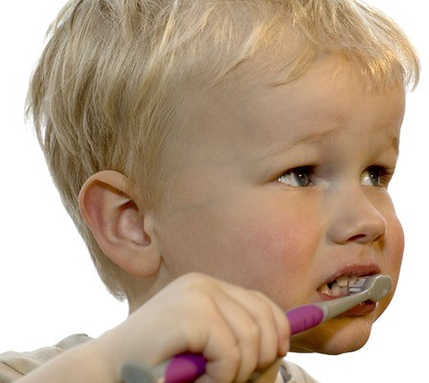
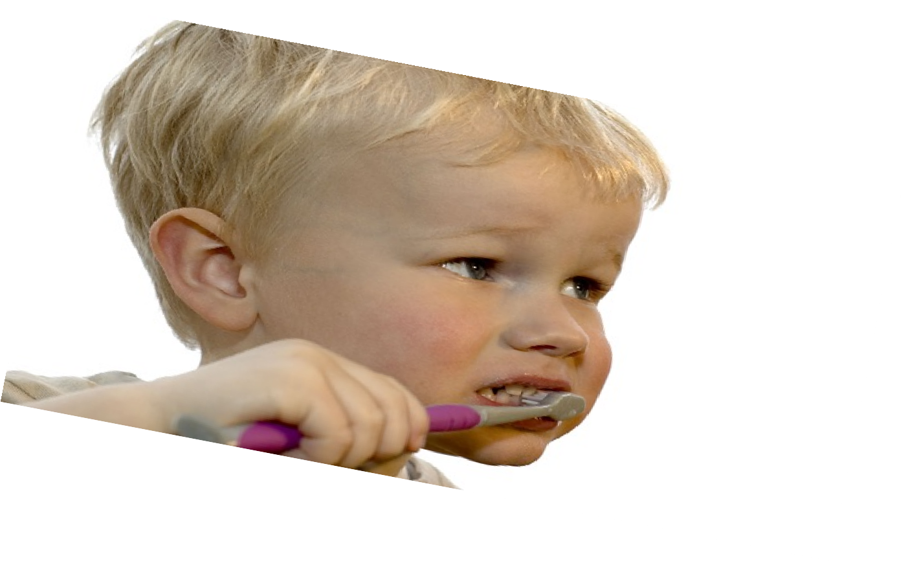
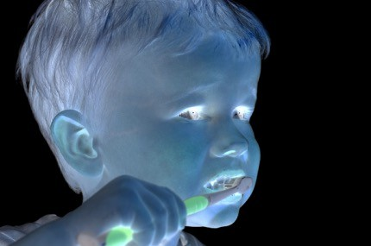
What types of image transformations can we do?
Filtering 1- no change in pixel location
2- some features disappears and other features are highlighted
Warping
changes pixel values
changes pixel locations

Slide 10
What types of image transformations can we do?
Filtering
Warping
changes range of image function
changes domain of image function

Slide 11
What types of image filtering can we do?
Point Operation
point processing
Neighborhood Operation
“filtering”

Slide 12
Point processing

Slide 13
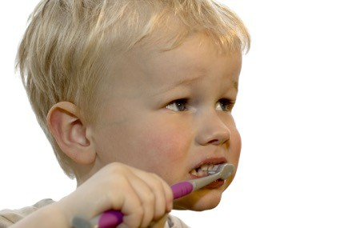
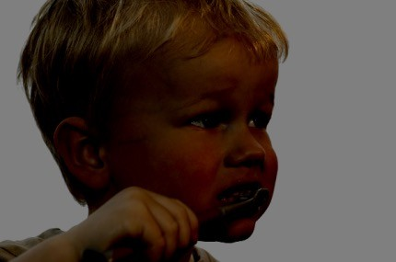
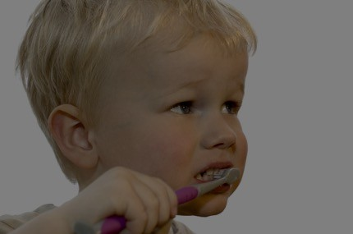
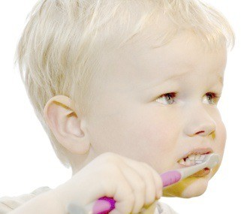
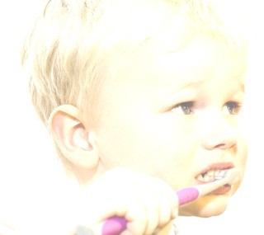
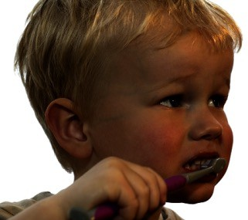
Examples of point processing
darken lower contrast non-linear lower contrast
original
invert
lighten
raise contrast
non-linear raise contrast

Slide 14
How would you implement these?
original
Examples of point processing
darken lower contrast non-linear lower contrast
invert
lighten
raise contrast
non-linear raise contrast

Slide 15
How would you implement these?
original
Examples of point processing
darken lower contrast non-linear lower contrast
invert
lighten
raise contrast
non-linear raise contrast

Slide 16
How would you implement these?
original
Examples of point processing
darken lower contrast non-linear lower contrast
invert
lighten
raise contrast
non-linear raise contrast

Slide 17
How would you implement these?
original
Examples of point processing
darken lower contrast non-linear lower contrast
invert
lighten
raise contrast
non-linear raise contrast

Slide 18
How would you implement these?
original
Examples of point processing
darken lower contrast non-linear lower contrast
invert
lighten
raise contrast
non-linear raise contrast

Slide 19
How would you implement these?
original
Examples of point processing
darken lower contrast non-linear lower contrast
invert
lighten
raise contrast
non-linear raise contrast

Slide 20
How would you implement these?
original
Examples of point processing
darken lower contrast non-linear lower contrast
invert
lighten
raise contrast
non-linear raise contrast

Slide 21
How would you implement these?
original
Examples of point processing
darken lower contrast non-linear lower contrast
invert
lighten
raise contrast
non-linear raise contrast

Slide 22
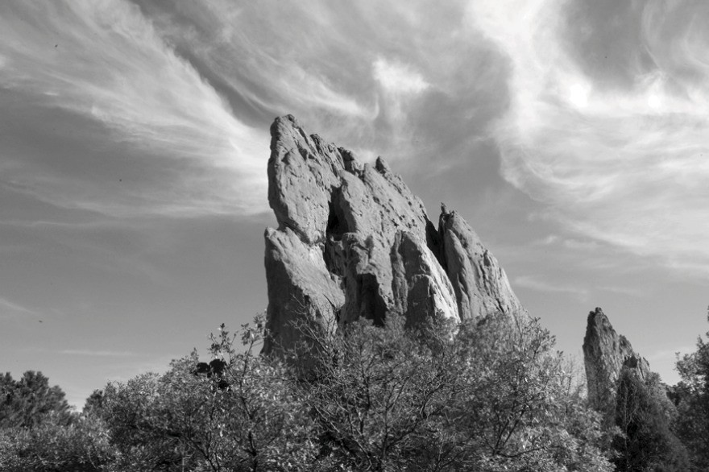
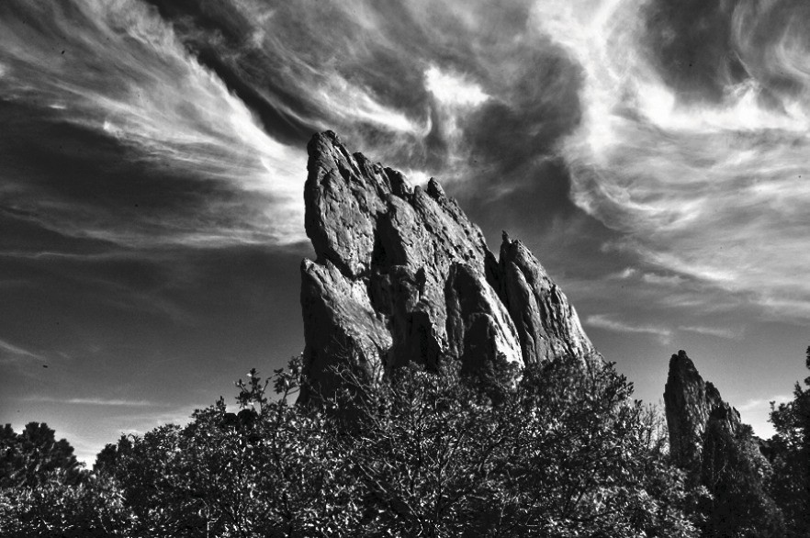
Many other types of point processing
camera output
image after stylistic tonemapping
[Bae et al., SIGGRAPH 2006]

Slide 23
Many other types of point processing
Gamma + effect could give wash out appearance

Slide 24
Linear shift-invariant image filtering

Slide 25
Linear shift-invariant image filtering
Replace each pixel by a linear combination of its neighbors (and possibly itself).
The combination is determined by the filter’s kernel , mask, window.
The same kernel is shifted to all pixel locations so that all pixels use the same linear combination of their neighbors.

Slide 26
Example: the box filter
also known as the 2D rect (not rekt) filter
also known as the square mean filter
1 | 1 | 1
1 | 1 | 1
1 | 1 | 1
kernel
replaces pixel with local average
has smoothing (blurring) effect

Slide 27
Let’s run the box filter
image
output
0 | 0 | 0 | 0 | 0 | 0 | 0 | 0 | 0 | 0
0 | 0 | 0 | 0 | 0 | 0 | 0 | 0 | 0 | 0
0 | 0 | 0 | 90 | 90 | 90 | 90 | 90 | 0 | 0
0 | 0 | 0 | 90 | 90 | 90 | 90 | 90 | 0 | 0
0 | 0 | 0 | 90 | 0 | 90 | 90 | 90 | 0 | 0
0 | 0 | 0 | 90 | 90 | 90 | 90 | 90 | 0 | 0
0 | 0 | 0 | 0 | 0 | 0 | 0 | 0 | 0 | 0
0 | 0 | 0 | 0 | 0 | 0 | 0 | 0 | 0 | 0
0 | 0 | 90 | 0 | 0 | 0 | 0 | 0 | 0 | 0
0 | 0 | 0 | 0 | 0 | 0 | 0 | 0 | 0 | 0
kernel
1 | 1 | 1
1 | 1 | 1
1 | 1 | 1
note that we assume that the kernel coordinates are centered
output
filter
image (signal)

Slide 28
Let’s run the box filter
image
output
0 | 0 | 0 | 0 | 0 | 0 | 0 | 0 | 0 | 0
0 | 0 | 0 | 0 | 0 | 0 | 0 | 0 | 0 | 0
0 | 0 | 0 | 90 | 90 | 90 | 90 | 90 | 0 | 0
0 | 0 | 0 | 90 | 90 | 90 | 90 | 90 | 0 | 0
0 | 0 | 0 | 90 | 0 | 90 | 90 | 90 | 0 | 0
0 | 0 | 0 | 90 | 90 | 90 | 90 | 90 | 0 | 0
0 | 0 | 0 | 0 | 0 | 0 | 0 | 0 | 0 | 0
0 | 0 | 0 | 0 | 0 | 0 | 0 | 0 | 0 | 0
0 | 0 | 90 | 0 | 0 | 0 | 0 | 0 | 0 | 0
0 | 0 | 0 | 0 | 0 | 0 | 0 | 0 | 0 | 0
 | 0
kernel
1 | 1 | 1
1 | 1 | 1
1 | 1 | 1
output
filter
image (signal)

Slide 29
Let’s run the box filter
image
output
0 | 0 | 0 | 0 | 0 | 0 | 0 | 0 | 0 | 0
0 | 0 | 0 | 0 | 0 | 0 | 0 | 0 | 0 | 0
0 | 0 | 0 | 90 | 90 | 90 | 90 | 90 | 0 | 0
0 | 0 | 0 | 90 | 90 | 90 | 90 | 90 | 0 | 0
0 | 0 | 0 | 90 | 0 | 90 | 90 | 90 | 0 | 0
0 | 0 | 0 | 90 | 90 | 90 | 90 | 90 | 0 | 0
0 | 0 | 0 | 0 | 0 | 0 | 0 | 0 | 0 | 0
0 | 0 | 0 | 0 | 0 | 0 | 0 | 0 | 0 | 0
0 | 0 | 90 | 0 | 0 | 0 | 0 | 0 | 0 | 0
0 | 0 | 0 | 0 | 0 | 0 | 0 | 0 | 0 | 0
0
kernel
1 | 1 | 1
1 | 1 | 1
1 | 1 | 1
shift-invariant: as the pixel shifts, so does the kernel
output
filter
image (signal)

Slide 30
Let’s run the box filter
image
output
0 | 0 | 0 | 0 | 0 | 0 | 0 | 0 | 0 | 0
0 | 0 | 0 | 0 | 0 | 0 | 0 | 0 | 0 | 0
0 | 0 | 0 | 90 | 90 | 90 | 90 | 90 | 0 | 0
0 | 0 | 0 | 90 | 90 | 90 | 90 | 90 | 0 | 0
0 | 0 | 0 | 90 | 0 | 90 | 90 | 90 | 0 | 0
0 | 0 | 0 | 90 | 90 | 90 | 90 | 90 | 0 | 0
0 | 0 | 0 | 0 | 0 | 0 | 0 | 0 | 0 | 0
0 | 0 | 0 | 0 | 0 | 0 | 0 | 0 | 0 | 0
0 | 0 | 90 | 0 | 0 | 0 | 0 | 0 | 0 | 0
0 | 0 | 0 | 0 | 0 | 0 | 0 | 0 | 0 | 0
 | 0 | 10
kernel
1 | 1 | 1
1 | 1 | 1
1 | 1 | 1
output
filter
image (signal)

Slide 31
Let’s run the box filter
image
output
0 | 0 | 0 | 0 | 0 | 0 | 0 | 0 | 0 | 0
0 | 0 | 0 | 0 | 0 | 0 | 0 | 0 | 0 | 0
0 | 0 | 0 | 90 | 90 | 90 | 90 | 90 | 0 | 0
0 | 0 | 0 | 90 | 90 | 90 | 90 | 90 | 0 | 0
0 | 0 | 0 | 90 | 0 | 90 | 90 | 90 | 0 | 0
0 | 0 | 0 | 90 | 90 | 90 | 90 | 90 | 0 | 0
0 | 0 | 0 | 0 | 0 | 0 | 0 | 0 | 0 | 0
0 | 0 | 0 | 0 | 0 | 0 | 0 | 0 | 0 | 0
0 | 0 | 90 | 0 | 0 | 0 | 0 | 0 | 0 | 0
0 | 0 | 0 | 0 | 0 | 0 | 0 | 0 | 0 | 0
 | 0 | 10
kernel
1 | 1 | 1
1 | 1 | 1
1 | 1 | 1
output
filter
image (signal)

Slide 32
Let’s run the box filter
image
output
0 | 0 | 0 | 0 | 0 | 0 | 0 | 0 | 0 | 0
0 | 0 | 0 | 0 | 0 | 0 | 0 | 0 | 0 | 0
0 | 0 | 0 | 90 | 90 | 90 | 90 | 90 | 0 | 0
0 | 0 | 0 | 90 | 90 | 90 | 90 | 90 | 0 | 0
0 | 0 | 0 | 90 | 0 | 90 | 90 | 90 | 0 | 0
0 | 0 | 0 | 90 | 90 | 90 | 90 | 90 | 0 | 0
0 | 0 | 0 | 0 | 0 | 0 | 0 | 0 | 0 | 0
0 | 0 | 0 | 0 | 0 | 0 | 0 | 0 | 0 | 0
0 | 0 | 90 | 0 | 0 | 0 | 0 | 0 | 0 | 0
0 | 0 | 0 | 0 | 0 | 0 | 0 | 0 | 0 | 0
 | 0 | 10 | 20
kernel
1 | 1 | 1
1 | 1 | 1
1 | 1 | 1
output
filter
image (signal)

Slide 33
Let’s run the box filter
image
output
0 | 0 | 0 | 0 | 0 | 0 | 0 | 0 | 0 | 0
0 | 0 | 0 | 0 | 0 | 0 | 0 | 0 | 0 | 0
0 | 0 | 0 | 90 | 90 | 90 | 90 | 90 | 0 | 0
0 | 0 | 0 | 90 | 90 | 90 | 90 | 90 | 0 | 0
0 | 0 | 0 | 90 | 0 | 90 | 90 | 90 | 0 | 0
0 | 0 | 0 | 90 | 90 | 90 | 90 | 90 | 0 | 0
0 | 0 | 0 | 0 | 0 | 0 | 0 | 0 | 0 | 0
0 | 0 | 0 | 0 | 0 | 0 | 0 | 0 | 0 | 0
0 | 0 | 90 | 0 | 0 | 0 | 0 | 0 | 0 | 0
0 | 0 | 0 | 0 | 0 | 0 | 0 | 0 | 0 | 0
 | 0 | 10 | 20
kernel
1 | 1 | 1
1 | 1 | 1
1 | 1 | 1
output
filter
image (signal)

Slide 34
Let’s run the box filter
image
output
0 | 0 | 0 | 0 | 0 | 0 | 0 | 0 | 0 | 0
0 | 0 | 0 | 0 | 0 | 0 | 0 | 0 | 0 | 0
0 | 0 | 0 | 90 | 90 | 90 | 90 | 90 | 0 | 0
0 | 0 | 0 | 90 | 90 | 90 | 90 | 90 | 0 | 0
0 | 0 | 0 | 90 | 0 | 90 | 90 | 90 | 0 | 0
0 | 0 | 0 | 90 | 90 | 90 | 90 | 90 | 0 | 0
0 | 0 | 0 | 0 | 0 | 0 | 0 | 0 | 0 | 0
0 | 0 | 0 | 0 | 0 | 0 | 0 | 0 | 0 | 0
0 | 0 | 90 | 0 | 0 | 0 | 0 | 0 | 0 | 0
0 | 0 | 0 | 0 | 0 | 0 | 0 | 0 | 0 | 0
 | 0 | 10 | 20 | 30
kernel
1 | 1 | 1
1 | 1 | 1
1 | 1 | 1
output
filter
image (signal)

Slide 35
Let’s run the box filter
image
output
0 | 0 | 0 | 0 | 0 | 0 | 0 | 0 | 0 | 0
0 | 0 | 0 | 0 | 0 | 0 | 0 | 0 | 0 | 0
0 | 0 | 0 | 90 | 90 | 90 | 90 | 90 | 0 | 0
0 | 0 | 0 | 90 | 90 | 90 | 90 | 90 | 0 | 0
0 | 0 | 0 | 90 | 0 | 90 | 90 | 90 | 0 | 0
0 | 0 | 0 | 90 | 90 | 90 | 90 | 90 | 0 | 0
0 | 0 | 0 | 0 | 0 | 0 | 0 | 0 | 0 | 0
0 | 0 | 0 | 0 | 0 | 0 | 0 | 0 | 0 | 0
0 | 0 | 90 | 0 | 0 | 0 | 0 | 0 | 0 | 0
0 | 0 | 0 | 0 | 0 | 0 | 0 | 0 | 0 | 0
 | 0 | 10 | 20 | 30 | 30
kernel
1 | 1 | 1
1 | 1 | 1
1 | 1 | 1
output
filter
image (signal)

Slide 36
Let’s run the box filter
image
output
0 | 0 | 0 | 0 | 0 | 0 | 0 | 0 | 0 | 0
0 | 0 | 0 | 0 | 0 | 0 | 0 | 0 | 0 | 0
0 | 0 | 0 | 90 | 90 | 90 | 90 | 90 | 0 | 0
0 | 0 | 0 | 90 | 90 | 90 | 90 | 90 | 0 | 0
0 | 0 | 0 | 90 | 0 | 90 | 90 | 90 | 0 | 0
0 | 0 | 0 | 90 | 90 | 90 | 90 | 90 | 0 | 0
0 | 0 | 0 | 0 | 0 | 0 | 0 | 0 | 0 | 0
0 | 0 | 0 | 0 | 0 | 0 | 0 | 0 | 0 | 0
0 | 0 | 90 | 0 | 0 | 0 | 0 | 0 | 0 | 0
0 | 0 | 0 | 0 | 0 | 0 | 0 | 0 | 0 | 0
 | 0 | 10 | 20 | 30 | 30 | 30
kernel
1 | 1 | 1
1 | 1 | 1
1 | 1 | 1
output
filter
image (signal)

Slide 37
Let’s run the box filter
image
output
0 | 0 | 0 | 0 | 0 | 0 | 0 | 0 | 0 | 0
0 | 0 | 0 | 0 | 0 | 0 | 0 | 0 | 0 | 0
0 | 0 | 0 | 90 | 90 | 90 | 90 | 90 | 0 | 0
0 | 0 | 0 | 90 | 90 | 90 | 90 | 90 | 0 | 0
0 | 0 | 0 | 90 | 0 | 90 | 90 | 90 | 0 | 0
0 | 0 | 0 | 90 | 90 | 90 | 90 | 90 | 0 | 0
0 | 0 | 0 | 0 | 0 | 0 | 0 | 0 | 0 | 0
0 | 0 | 0 | 0 | 0 | 0 | 0 | 0 | 0 | 0
0 | 0 | 90 | 0 | 0 | 0 | 0 | 0 | 0 | 0
0 | 0 | 0 | 0 | 0 | 0 | 0 | 0 | 0 | 0
 | 0 | 10 | 20 | 30 | 30 | 30 | 20
kernel
1 | 1 | 1
1 | 1 | 1
1 | 1 | 1
output
filter
image (signal)

Slide 38
Let’s run the box filter
image
output
0 | 0 | 0 | 0 | 0 | 0 | 0 | 0 | 0 | 0
0 | 0 | 0 | 0 | 0 | 0 | 0 | 0 | 0 | 0
0 | 0 | 0 | 90 | 90 | 90 | 90 | 90 | 0 | 0
0 | 0 | 0 | 90 | 90 | 90 | 90 | 90 | 0 | 0
0 | 0 | 0 | 90 | 0 | 90 | 90 | 90 | 0 | 0
0 | 0 | 0 | 90 | 90 | 90 | 90 | 90 | 0 | 0
0 | 0 | 0 | 0 | 0 | 0 | 0 | 0 | 0 | 0
0 | 0 | 0 | 0 | 0 | 0 | 0 | 0 | 0 | 0
0 | 0 | 90 | 0 | 0 | 0 | 0 | 0 | 0 | 0
0 | 0 | 0 | 0 | 0 | 0 | 0 | 0 | 0 | 0
 | 0 | 10 | 20 | 30 | 30 | 30 | 20 | 10
kernel
1 | 1 | 1
1 | 1 | 1
1 | 1 | 1
output
filter
image (signal)

Slide 39
Let’s run the box filter
image
output
0 | 0 | 0 | 0 | 0 | 0 | 0 | 0 | 0 | 0
0 | 0 | 0 | 0 | 0 | 0 | 0 | 0 | 0 | 0
0 | 0 | 0 | 90 | 90 | 90 | 90 | 90 | 0 | 0
0 | 0 | 0 | 90 | 90 | 90 | 90 | 90 | 0 | 0
0 | 0 | 0 | 90 | 0 | 90 | 90 | 90 | 0 | 0
0 | 0 | 0 | 90 | 90 | 90 | 90 | 90 | 0 | 0
0 | 0 | 0 | 0 | 0 | 0 | 0 | 0 | 0 | 0
0 | 0 | 0 | 0 | 0 | 0 | 0 | 0 | 0 | 0
0 | 0 | 90 | 0 | 0 | 0 | 0 | 0 | 0 | 0
0 | 0 | 0 | 0 | 0 | 0 | 0 | 0 | 0 | 0
 | 0 | 10 | 20 | 30 | 30 | 30 | 20 | 10
 | 0
kernel
1 | 1 | 1
1 | 1 | 1
1 | 1 | 1
output
filter
image (signal)

Slide 40
Let’s run the box filter
image
output
0 | 0 | 0 | 0 | 0 | 0 | 0 | 0 | 0 | 0
0 | 0 | 0 | 0 | 0 | 0 | 0 | 0 | 0 | 0
0 | 0 | 0 | 90 | 90 | 90 | 90 | 90 | 0 | 0
0 | 0 | 0 | 90 | 90 | 90 | 90 | 90 | 0 | 0
0 | 0 | 0 | 90 | 0 | 90 | 90 | 90 | 0 | 0
0 | 0 | 0 | 90 | 90 | 90 | 90 | 90 | 0 | 0
0 | 0 | 0 | 0 | 0 | 0 | 0 | 0 | 0 | 0
0 | 0 | 0 | 0 | 0 | 0 | 0 | 0 | 0 | 0
0 | 0 | 90 | 0 | 0 | 0 | 0 | 0 | 0 | 0
0 | 0 | 0 | 0 | 0 | 0 | 0 | 0 | 0 | 0
 | 0 | 10 | 20 | 30 | 30 | 30 | 20 | 10
 | 0 | 20
kernel
1 | 1 | 1
1 | 1 | 1
1 | 1 | 1
output
filter
image (signal)

Slide 41
Let’s run the box filter
image
output
0 | 0 | 0 | 0 | 0 | 0 | 0 | 0 | 0 | 0
0 | 0 | 0 | 0 | 0 | 0 | 0 | 0 | 0 | 0
0 | 0 | 0 | 90 | 90 | 90 | 90 | 90 | 0 | 0
0 | 0 | 0 | 90 | 90 | 90 | 90 | 90 | 0 | 0
0 | 0 | 0 | 90 | 0 | 90 | 90 | 90 | 0 | 0
0 | 0 | 0 | 90 | 90 | 90 | 90 | 90 | 0 | 0
0 | 0 | 0 | 0 | 0 | 0 | 0 | 0 | 0 | 0
0 | 0 | 0 | 0 | 0 | 0 | 0 | 0 | 0 | 0
0 | 0 | 90 | 0 | 0 | 0 | 0 | 0 | 0 | 0
0 | 0 | 0 | 0 | 0 | 0 | 0 | 0 | 0 | 0
 | 0 | 10 | 20 | 30 | 30 | 30 | 20 | 10
 | 0 | 20 | 40
kernel
1 | 1 | 1
1 | 1 | 1
1 | 1 | 1
output
filter
image (signal)

Slide 42
Let’s run the box filter
image
output
0 | 0 | 0 | 0 | 0 | 0 | 0 | 0 | 0 | 0
0 | 0 | 0 | 0 | 0 | 0 | 0 | 0 | 0 | 0
0 | 0 | 0 | 90 | 90 | 90 | 90 | 90 | 0 | 0
0 | 0 | 0 | 90 | 90 | 90 | 90 | 90 | 0 | 0
0 | 0 | 0 | 90 | 0 | 90 | 90 | 90 | 0 | 0
0 | 0 | 0 | 90 | 90 | 90 | 90 | 90 | 0 | 0
0 | 0 | 0 | 0 | 0 | 0 | 0 | 0 | 0 | 0
0 | 0 | 0 | 0 | 0 | 0 | 0 | 0 | 0 | 0
0 | 0 | 90 | 0 | 0 | 0 | 0 | 0 | 0 | 0
0 | 0 | 0 | 0 | 0 | 0 | 0 | 0 | 0 | 0
 | 0 | 10 | 20 | 30 | 30 | 30 | 20 | 10
 | 0 | 20 | 40 | 60 | 60 | 60 | 40 | 20
 | 0
kernel
1 | 1 | 1
1 | 1 | 1
1 | 1 | 1
output
filter
image (signal)

Slide 43
Let’s run the box filter
image
output
0 | 0 | 0 | 0 | 0 | 0 | 0 | 0 | 0 | 0
0 | 0 | 0 | 0 | 0 | 0 | 0 | 0 | 0 | 0
0 | 0 | 0 | 90 | 90 | 90 | 90 | 90 | 0 | 0
0 | 0 | 0 | 90 | 90 | 90 | 90 | 90 | 0 | 0
0 | 0 | 0 | 90 | 0 | 90 | 90 | 90 | 0 | 0
0 | 0 | 0 | 90 | 90 | 90 | 90 | 90 | 0 | 0
0 | 0 | 0 | 0 | 0 | 0 | 0 | 0 | 0 | 0
0 | 0 | 0 | 0 | 0 | 0 | 0 | 0 | 0 | 0
0 | 0 | 90 | 0 | 0 | 0 | 0 | 0 | 0 | 0
0 | 0 | 0 | 0 | 0 | 0 | 0 | 0 | 0 | 0
 | 0 | 10 | 20 | 30 | 30 | 30 | 20 | 10
 | 0 | 20 | 40 | 60 | 60 | 60 | 40 | 20
 | 0 | 30
kernel
1 | 1 | 1
1 | 1 | 1
1 | 1 | 1
output
filter
image (signal)

Slide 44
Let’s run the box filter
image
output
0 | 0 | 0 | 0 | 0 | 0 | 0 | 0 | 0 | 0
0 | 0 | 0 | 0 | 0 | 0 | 0 | 0 | 0 | 0
0 | 0 | 0 | 90 | 90 | 90 | 90 | 90 | 0 | 0
0 | 0 | 0 | 90 | 90 | 90 | 90 | 90 | 0 | 0
0 | 0 | 0 | 90 | 0 | 90 | 90 | 90 | 0 | 0
0 | 0 | 0 | 90 | 90 | 90 | 90 | 90 | 0 | 0
0 | 0 | 0 | 0 | 0 | 0 | 0 | 0 | 0 | 0
0 | 0 | 0 | 0 | 0 | 0 | 0 | 0 | 0 | 0
0 | 0 | 90 | 0 | 0 | 0 | 0 | 0 | 0 | 0
0 | 0 | 0 | 0 | 0 | 0 | 0 | 0 | 0 | 0
 | 0 | 10 | 20 | 30 | 30 | 30 | 20 | 10
 | 0 | 20 | 40 | 60 | 60 | 60 | 40 | 20
 | 0 | 30 | 50 | 80 | 80 | 90 | 60 | 30
 | 0 | 30 | 50 | 80 | 80 | 90 | 60 | 30
 | 0 | 20 | 30 | 50 | 50 | 60 | 40 | 20
 | 0 | 10 | 20 | 30 | 30 | 30 | 20 | 10
 | 10 | 10 | 10 | 10 | 0 | 0 | 0 | 0
 | 10
kernel
1 | 1 | 1
1 | 1 | 1
1 | 1 | 1
output
filter
image (signal)

Slide 45
Let’s run the box filter
image
output
0 | 0 | 0 | 0 | 0 | 0 | 0 | 0 | 0 | 0
0 | 0 | 0 | 0 | 0 | 0 | 0 | 0 | 0 | 0
0 | 0 | 0 | 90 | 90 | 90 | 90 | 90 | 0 | 0
0 | 0 | 0 | 90 | 90 | 90 | 90 | 90 | 0 | 0
0 | 0 | 0 | 90 | 0 | 90 | 90 | 90 | 0 | 0
0 | 0 | 0 | 90 | 90 | 90 | 90 | 90 | 0 | 0
0 | 0 | 0 | 0 | 0 | 0 | 0 | 0 | 0 | 0
0 | 0 | 0 | 0 | 0 | 0 | 0 | 0 | 0 | 0
0 | 0 | 90 | 0 | 0 | 0 | 0 | 0 | 0 | 0
0 | 0 | 0 | 0 | 0 | 0 | 0 | 0 | 0 | 0
 | 0 | 10 | 20 | 30 | 30 | 30 | 20 | 10
 | 0 | 20 | 40 | 60 | 60 | 60 | 40 | 20
 | 0 | 30 | 50 | 80 | 80 | 90 | 60 | 30
 | 0 | 30 | 50 | 80 | 80 | 90 | 60 | 30
 | 0 | 20 | 30 | 50 | 50 | 60 | 40 | 20
 | 0 | 10 | 20 | 30 | 30 | 30 | 20 | 10
 | 10 | 10 | 10 | 10 | 0 | 0 | 0 | 0
 | 10 | 10 | 10 | 10 | 0 | 0 | 0 | 0
kernel
1 | 1 | 1
1 | 1 | 1
1 | 1 | 1
output
filter
image (signal)

Slide 46
… and the result is
image
output
0 | 0 | 0 | 0 | 0 | 0 | 0 | 0 | 0 | 0
0 | 0 | 0 | 0 | 0 | 0 | 0 | 0 | 0 | 0
0 | 0 | 0 | 90 | 90 | 90 | 90 | 90 | 0 | 0
0 | 0 | 0 | 90 | 90 | 90 | 90 | 90 | 0 | 0
0 | 0 | 0 | 90 | 0 | 90 | 90 | 90 | 0 | 0
0 | 0 | 0 | 90 | 90 | 90 | 90 | 90 | 0 | 0
0 | 0 | 0 | 0 | 0 | 0 | 0 | 0 | 0 | 0
0 | 0 | 0 | 0 | 0 | 0 | 0 | 0 | 0 | 0
0 | 0 | 90 | 0 | 0 | 0 | 0 | 0 | 0 | 0
0 | 0 | 0 | 0 | 0 | 0 | 0 | 0 | 0 | 0
 | 0 | 10 | 20 | 30 | 30 | 30 | 20 | 10
 | 0 | 20 | 40 | 60 | 60 | 60 | 40 | 20
 | 0 | 30 | 50 | 80 | 80 | 90 | 60 | 30
 | 0 | 30 | 50 | 80 | 80 | 90 | 60 | 30
 | 0 | 20 | 30 | 50 | 50 | 60 | 40 | 20
 | 0 | 10 | 20 | 30 | 30 | 30 | 20 | 10
 | 10 | 10 | 10 | 10 | 0 | 0 | 0 | 0
 | 10 | 10 | 10 | 10 | 0 | 0 | 0 | 0
kernel
1 | 1 | 1
1 | 1 | 1
1 | 1 | 1
output
filter
image (signal)

Slide 47
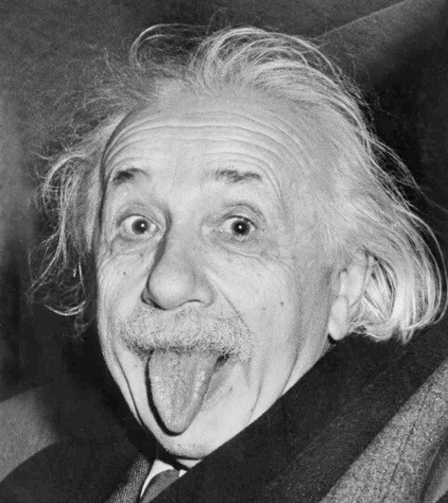
Some more realistic examples

Slide 48
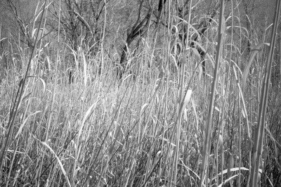
Some more realistic examples

Slide 49
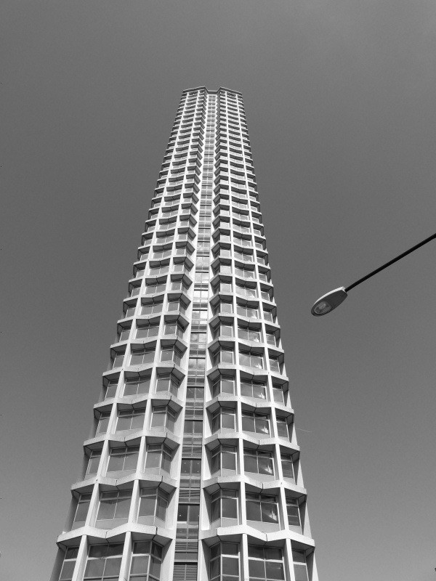
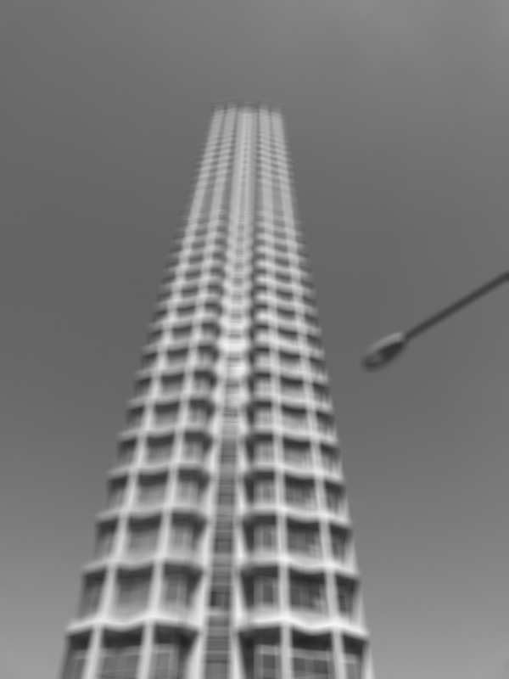
Some more realistic examples

Slide 50
Convolution

Slide 51
Convolution for 1D continuous signals
Definition of filtering as convolution:
notice the flip
- Sign represents flipping the image
filtered signal
filter
input signal

Slide 52
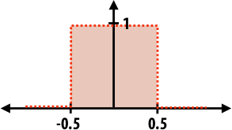
Convolution for 1D continuous signals
Definition of filtering as convolution:
notice the flip
filtered signal
filter
input signal
Consider the box filter example:
1D continuous box filter
filtering output is a blurred version of g

Slide 53
Convolution for 2D discrete signals
Definition of filtering as convolution:
notice the flip
filtered image
filter
input image

Slide 54
Convolution for 2D discrete signals
Definition of filtering as convolution:
notice the flip
filtered image
If the filter then
filter
input image
is non-zero only within
,
The kernel we saw earlier is the 3x3 matrix representation of
.

Slide 55
Convolution vs correlation
Definition of filtering as convolution:
notice the flip
Definition of filtering as correlation:
notice the lack of a flip
Most of the time won’t matter, because our kernels will be symmetric.
Will be important when we discuss frequency-domain filtering (lectures 5-6).

Slide 56
Separable filters
A 2D filter is separable if it can be written as the product of a “column” and a “row”.
1 | 1 | 1
1 | 1 | 1
1 | 1 | 1
1
1
1
1 | 1 | 1
example: box filter
=
*
row
column
What is the rank of this filter matrix?

Slide 57
Separable filters
A 2D filter is separable if it can be written as the product of a “column” and a “row”.
1 | 1 | 1
1 | 1 | 1
1 | 1 | 1
1
1
1
1 | 1 | 1
example: box filter
=
*
row
column
Why is this important?

Slide 58
Separable filters
A 2D filter is separable if it can be written as the product of a “column” and a “row”.
1 | 1 | 1
1 | 1 | 1
1 | 1 | 1
1
1
1
1 | 1 | 1
example: box filter
=
*
row
column
2D convolution with a separable filter is equivalent to two 1D convolutions (with the “column” and “row” filters).

Slide 59
Separable filters
A 2D filter is separable if it can be written as the product of a “column” and a “row”.
1 | 1 | 1
1 | 1 | 1
1 | 1 | 1
1
1
1
1 | 1 | 1
example: box filter
=
*
row
column
2D convolution with a separable filter is equivalent to two 1D convolutions (with the “column” and “row” filters).
If the image has M x M pixels and the filter kernel has size N x N:
What is the cost of convolution with a non-separable filter?

Slide 60
Separable filters
A 2D filter is separable if it can be written as the product of a “column” and a “row”.
1 | 1 | 1
1 | 1 | 1
1 | 1 | 1
1
1
1
1 | 1 | 1
example: box filter
=
*
row
column
2D convolution with a separable filter is equivalent to two 1D convolutions (with the “column” and “row” filters).
If the image has M x M pixels and the filter kernel has size N x N:
What is the cost of convolution with a non-separable filter?
What is the cost of convolution with a separable filter?
M² x N²

Slide 61
Separable filters
A 2D filter is separable if it can be written as the product of a “column” and a “row”.
1 | 1 | 1
1 | 1 | 1
1 | 1 | 1
1
1
1
1 | 1 | 1
example: box filter
=
*
row
column
2D convolution with a separable filter is equivalent to two 1D convolutions (with the “column” and “row” filters).
If the image has M x M pixels and the filter kernel has size N x N:
What is the cost of convolution with a non-separable filter?
What is the cost of convolution with a separable filter?
M² x N²
2 x N x M²

Slide 62
A few more filters
do you see any problems in this image?
original
3x3 box filter

Slide 63
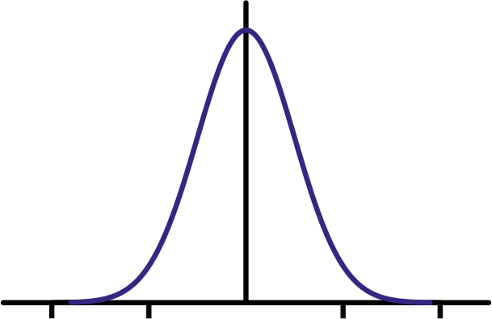
The Gaussian filter
named (like many other things) after Carl Friedrich Gauss
kernel values sampled from the 2D Gaussian function:
weight falls off with distance from center pixel
theoretically infinite, in practice truncated to some maximum distance
Any heuristics for selecting where to truncate?

Slide 64
The Gaussian filter
named (like many other things) after Carl Friedrich Gauss
kernel values sampled from the 2D Gaussian function:
weight falls off with distance from center pixel
theoretically infinite, in practice truncated to some maximum distance
Any heuristics for selecting where to truncate?
usually at 2-3σ
Is this a separable filter?
1 | 2 | 1
2 | 4 | 2
1 | 2 | 1
1
16
kernel

Slide 65
The Gaussian filter
named (like many other things) after Carl Friedrich Gauss
kernel values sampled from the 2D Gaussian function:
weight falls off with distance from center pixel
theoretically infinite, in practice truncated to some maximum distance
Any heuristics for selecting where to truncate?
usually at 2-3σ
Is this a separable filter?
Yes!
1 | 2 | 1
2 | 4 | 2
1 | 2 | 1
1
16
kernel

Slide 66
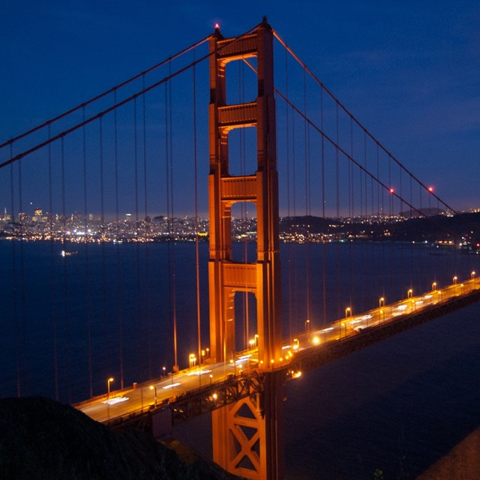
Gaussian filtering example

Slide 67
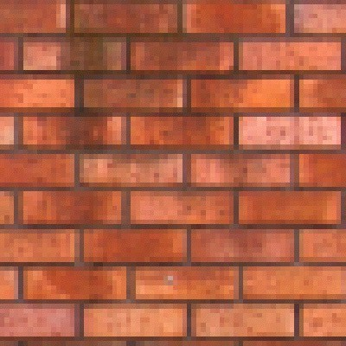
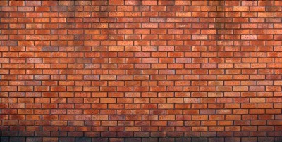
Gaussian vs box filtering
original
Which blur do you like better?

Slide 68
Gaussian vs box filtering
7x7 Gaussian
original
Which blur do you like better?
7x7 box

Slide 69
How would you create a soft shadow effect?

Slide 70
How would you create a soft shadow effect?
overlay
Gaussian blur

Slide 71
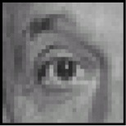
Other filters
output
?
input
filter
0 | 0 | 0
0 | 1 | 0
0 | 0 | 0

Slide 72
Other filters
input
filter
output
0 | 0 | 0
0 | 1 | 0
0 | 0 | 0
?
unchanged

Slide 73
Other filters
input
filter
output
0 | 0 | 0
0 | 1 | 0
0 | 0 | 0
?
unchanged
output
?
input
filter
0 | 0 | 0
0 | 0 | 1
0 | 0 | 0

Slide 74
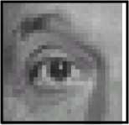
Other filters
input
filter
output
0 | 0 | 0
0 | 1 | 0
0 | 0 | 0
?
unchanged
input
filter
output
0 | 0 | 0
0 | 0 | 1
0 | 0 | 0
?
shift to left by one

Slide 75
Other filters
input
filter
output
0 | 0 | 0
0 | 2 | 0
0 | 0 | 0
1 | 1 | 1
1 | 1 | 1
1 | 1 | 1
?
-

Slide 76
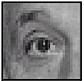
Other filters
input
filter
output
0 | 0 | 0
0 | 2 | 0
0 | 0 | 0
1 | 1 | 1
1 | 1 | 1
1 | 1 | 1
?
-
sharpening
do nothing for flat areas
stress intensity peaks

Slide 77
Sharpening examples

Slide 78
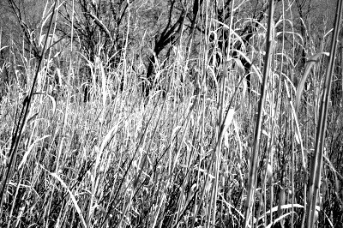
Sharpening examples

Slide 79
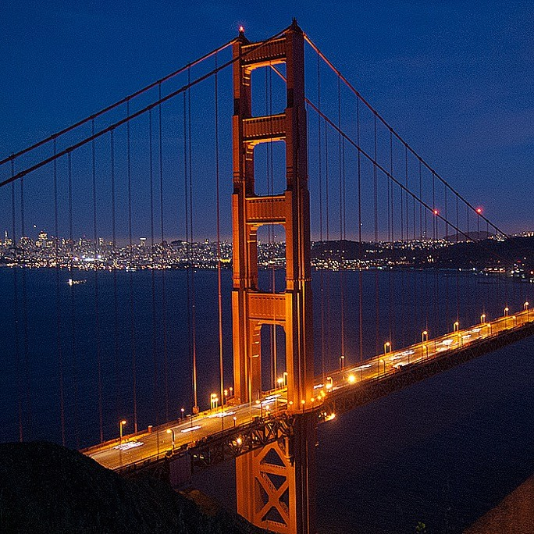
Sharpening examples

Slide 80
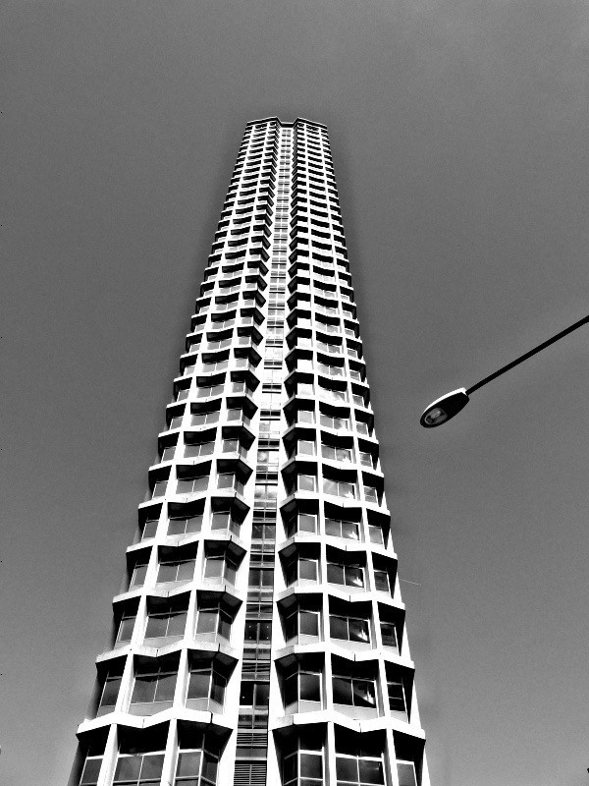
Sharpening examples

Slide 81
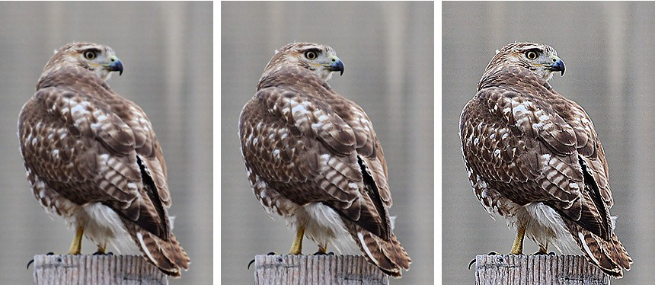
Do not overdo it with sharpening
oversharpened
What is wrong in this image?
original
sharpened

Slide 82
Image gradients

Slide 83
What are image edges?
Very sharp discontinuities in intensity.
grayscale image
domain

Slide 84
Detecting edges
How would you go about detecting edges in an image (i.e., discontinuities in a function)?

Slide 85
Detecting edges
How would you go about detecting edges in an image (i.e., discontinuities in a function)?
You take derivatives: derivatives are large at discontinuities.
How do you differentiate a discrete image (or any other discrete signal)?

Slide 86
Detecting edges
How would you go about detecting edges in an image (i.e., discontinuities in a function)?
You take derivatives: derivatives are large at discontinuities.
How do you differentiate a discrete image (or any other discrete signal)?
You use finite differences.

Slide 87
Finite differences
High-school reminder: definition of a derivative using forward difference

Slide 88
Finite differences
High-school reminder: definition of a derivative using forward difference
Alternative: use central difference
For discrete signals: Remove limit and set h = 2
What convolution kernel does this correspond to?

Slide 89
Finite differences
High-school reminder: definition of a derivative using forward difference
Alternative: use central difference
For discrete signals: Remove limit and set h = 2
?
?
-1 | 0 | 1
1 | 0 | -1

Slide 90
Finite differences
High-school reminder: definition of a derivative using forward difference
Alternative: use central difference
For discrete signals: Remove limit and set h = 2
1D derivative filter
1 | 0 | -1

Slide 91
The Sobel filter
1 | 0 | -1
2 | 0 | -2
1 | 0 | -1
1
2
1
1 | 0 | -1
=
*
1D derivative filter
Sobel filter
What filter is this?

Slide 92
The Sobel filter
1 | 0 | -1
2 | 0 | -2
1 | 0 | -1
1
2
1
1 | 0 | -1
=
*
1D derivative filter
Sobel filter Blurring
Does this filter return large responses on vertical or horizontal lines?

Slide 93
The Sobel filter
Horizontal Sober filter:
1 | 0 | -1
2 | 0 | -2
1 | 0 | -1
1
2
1
1 | 0 | -1
=
*
What does the vertical Sobel filter look like?

Slide 94
The Sobel filter
Horizontal Sober filter:
1 | 0 | -1
2 | 0 | -2
1 | 0 | -1
1
2
1
1 | 0 | -1
=
*
Vertical Sobel filter:
1 | 2 | 1
0 | 0 | 0
-1 | -2 | -1
1
0
-1
1 | 2 | 1
=
*

Slide 95
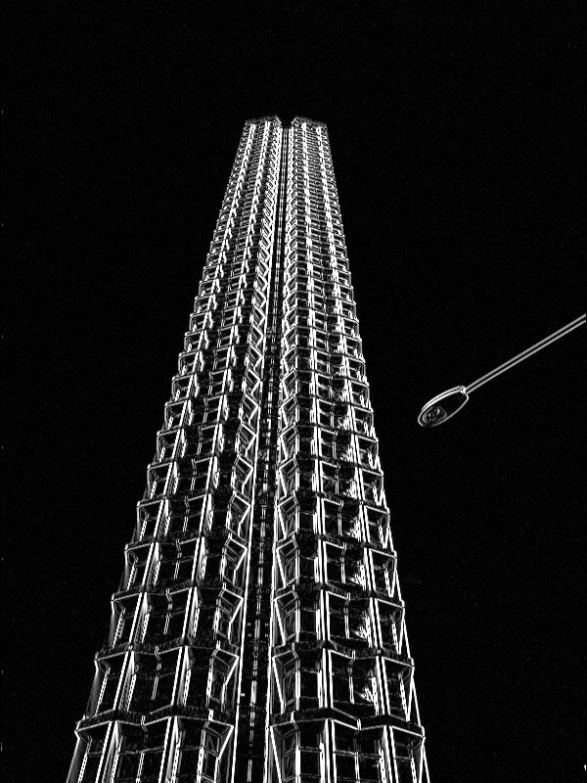
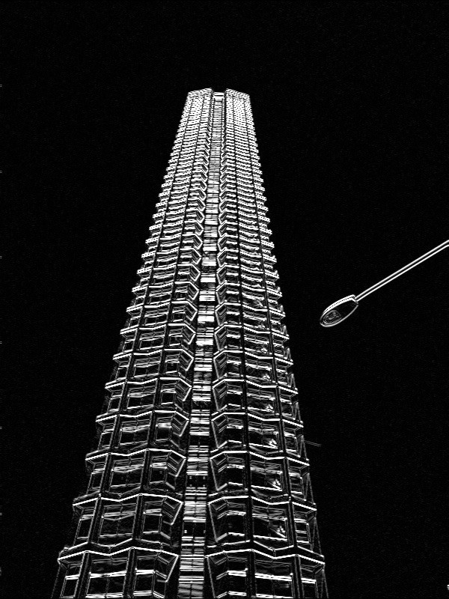
Sobel filter example
original
which Sobel filter?
which Sobel filter?

Slide 96
Sobel filter example
original
horizontal Sobel filter
vertical Sobel filter

Slide 97
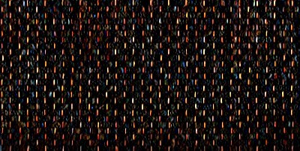
Sobel filter example
horizontal Sobel filter
original
vertical Sobel filter

Slide 98
Several derivative filters
1 | 0 | -1
2 | 0 | -2
1 | 0 | -1
1 | 2 | 1
0 | 0 | 0
-1 | -2 | -1
3 | 0 | -3
10 | 0 | -10
3 | 0 | -3
3 | 10 | 3
0 | 0 | 0
-3 | -10 | -3
Sobel
Scharr
1 | 0 | -1
1 | 0 | -1
1 | 0 | -1
1 | 1 | 1
0 | 0 | 0
-1 | -1 | -1
0 | 1
-1 | 0
1 | 0
0 | -1
Prewitt
Roberts
How are the other filters derived and how do they relate to the Sobel filter?
How would you derive a derivative filter that is larger than 3x3?

Slide 99
Computing image gradients
1. Select your favorite derivative filters.
1 | 0 | -1
2 | 0 | -2
1 | 0 | -1
1 | 2 | 1
0 | 0 | 0
-1 | -2 | -1

Slide 100
Computing image gradients
1. Select your favorite derivative filters.
1 | 0 | -1
2 | 0 | -2
1 | 0 | -1
1 | 2 | 1
0 | 0 | 0
-1 | -2 | -1
2. Convolve with the image to compute derivatives.

Slide 101
Computing image gradients
1. Select your favorite derivative filters.
1 | 0 | -1
2 | 0 | -2
1 | 0 | -1
1 | 2 | 1
0 | 0 | 0
-1 | -2 | -1
2. Convolve with the image to compute derivatives.
3. Form the image gradient, and compute its direction and amplitude.
gradient
direction
amplitude

Slide 102
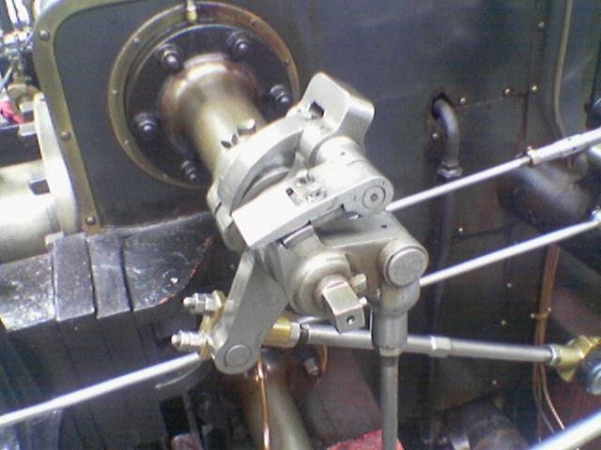
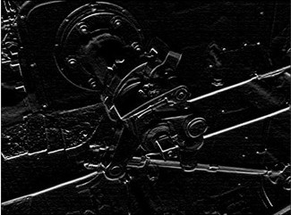
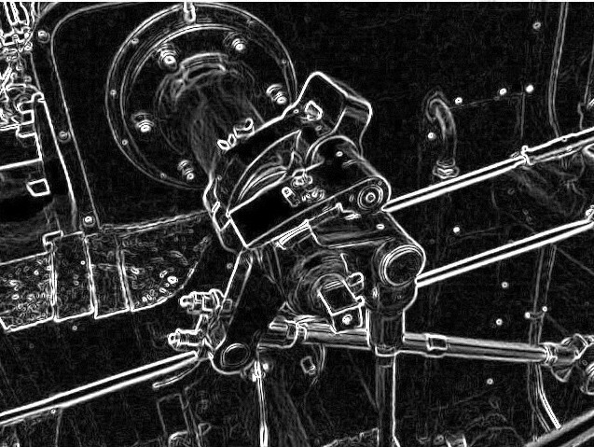
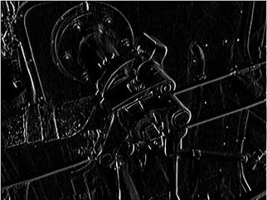
Image gradient example
vertical derivative
original
gradient amplitude
horizontal derivative
How does the gradient direction relate to these edges?

Slide 103
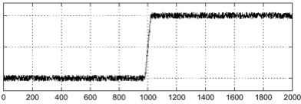
How do you find the edge of this signal?
intensity plot

Slide 104
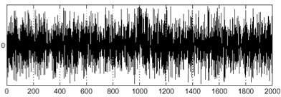
How do you find the edge of this signal?
intensity plot
Using a derivative filter:
What’s the problem here?
derivative plot

Slide 105
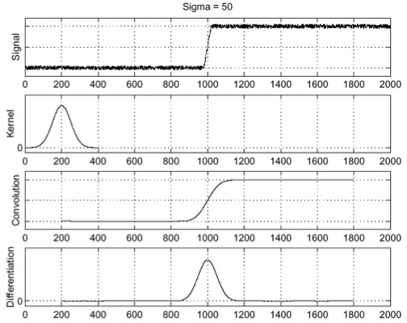
Differentiation is very sensitive to noise
When using derivative filters, it is critical to blur first!
input Gaussian blurred
derivative of blurred
How much should we blur?

Slide 106
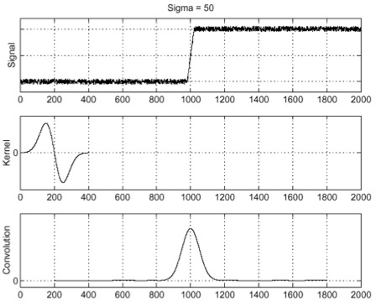
Derivative of Gaussian (DoG) filter
Derivative theorem of convolution:
input
derivative of Gaussian
output (same as before)
How many operations did we save?

Slide 107
Laplace filter
Basically a second derivative filter.
We can use finite differences to derive it, as with first derivative filter.
first-order finite difference
1D derivative filter
1 | 0 | -1
second-order finite difference
Laplace filter
?

Slide 108
Laplace filter
Basically a second derivative filter.
We can use finite differences to derive it, as with first derivative filter.
first-order finite difference
1D derivative filter
1 | 0 | -1
second-order finite difference
Laplace filter
1 | -2 | 1

Slide 109
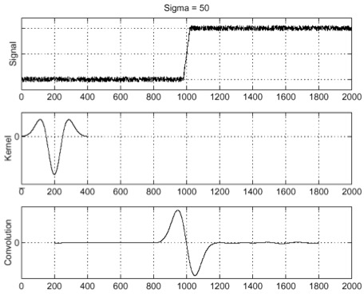
Laplacian of Gaussian (LoG) filter
As with derivative, we can combine Laplace filtering with Gaussian filtering
input
Laplacian of Gaussian
output
?

Slide 110
Laplacian of Gaussian (LoG) filter
As with derivative, we can combine Laplace filtering with Gaussian filtering
input
Laplacian of Gaussian
output
“zero crossings” at edges

Slide 111
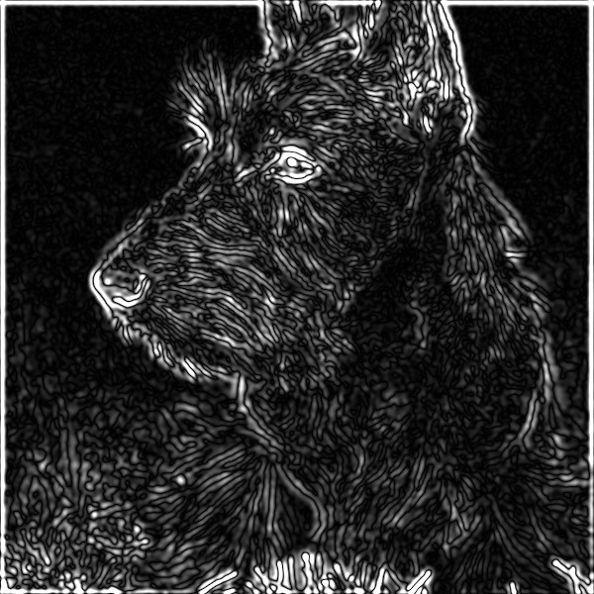
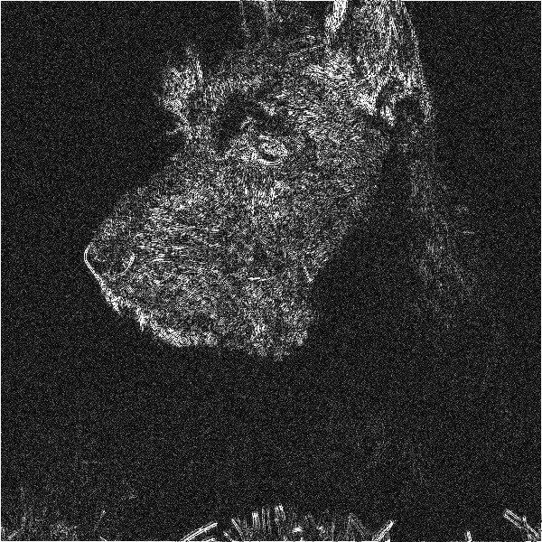
Laplace and LoG filtering examples
Laplacian of Gaussian filtering
Laplace filtering

Slide 112
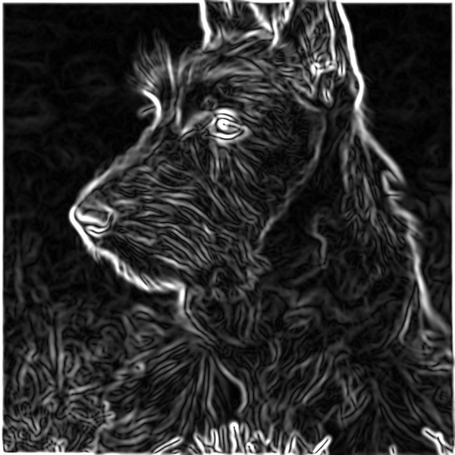
Laplacian of Gaussian vs Derivative of Gaussian
Laplacian of Gaussian filtering
Derivative of Gaussian filtering

Slide 113
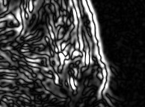
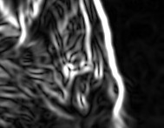
Laplacian of Gaussian vs Derivative of Gaussian
zero-crossing
peak
Laplacian of Gaussian filtering Derivative of Gaussian filtering
Zero crossings are more accurate at localizing edges (but not very convenient).

Slide 114
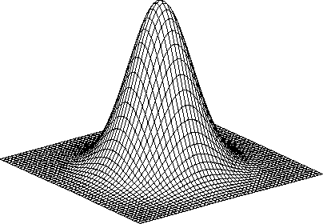
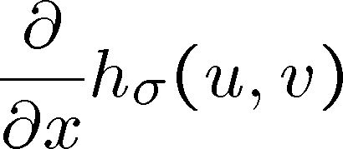
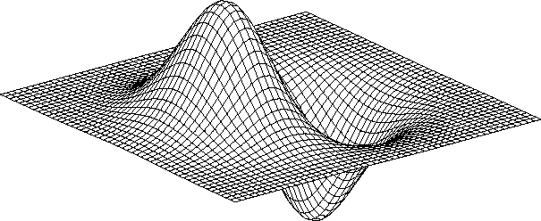
2D Gaussian filters
Gaussian
Derivative of Gaussian
how does this relate to this lecture’s cover picture?
Laplacian of Gaussian

